Slide 1


The Art of Design Patterns
2023
Prepared By:
Mohamed Samy
Notes:
Greetings , welcome to the Art of design patterns + Who am I?

Slide 2



What is a Design Pattern🤔?
Design patterns are Typical Solutions to commonly occurring problems in software design.
They are like pre-made Blueprints / Recipes that you can customize to solve a recurring design problem in your code.
You can’t just find a pattern and copy it into your program like functions or libraries. The pattern is not a specific piece of code, but a general concept
Notes:
Typical Sol Blueprint / Recipe Not a piece of code

Slide 3



Three types of Design Patterns👌🏻
Creational
Behavioral
Structural

Slide 4
Agenda
Creational Design Patterns
Singleton
Abstract Factory
Builder
Creational

Slide 5
Creational Design Patterns
Creational design patterns provide various object creation mechanisms, which increase flexibility and reuse of existing code.
Notes:
Usually deals with constructors, object creation

Slide 6
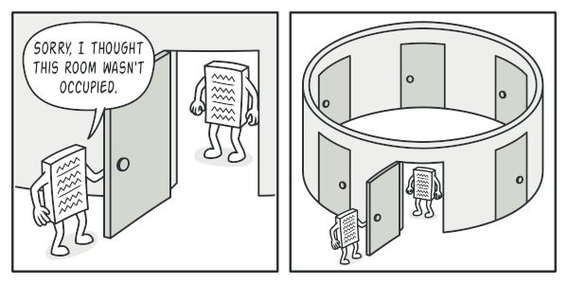
Singleton
Notes:
Remember that design patterns are known solutions to common problems

Slide 7
Problem ?
What does a regular family house kitchen contain? 👨🏻‍👩🏽‍👧‍👦🏿
How many Spoons ?
Stoves ?
Plates ?
Refrigerators ?

Slide 8

Imagine if every member had his own stove🤔
🙍🏻‍♂️
👦🏿
👩🏽
👧
Notes:
Is there a problem?

Slide 9
This creates many issues
Stoves are very expensive to get 💵💵
They consume a lot of the houses space 🏠
More ovens consume more gas -> more risk of gas leak or fires🔥

Slide 10
That’s why kitchens usually have a Single stove
🙍🏻‍♂️
👦🏿
👩🏽
👧

Slide 11
That’s why kitchens usually have a Single stove
👨🏻
🙍🏻‍♂️
👦🏿
👩🏽
👧

Slide 12
That’s why normal kitchens have a Single stove
👨🏻
🙍🏻‍♂️
👦🏿
Less money spent 💵
More kitchen space
Less risk of gas leak
👩🏽
👧
More efficient resources utilization

Slide 13
What is a Singleton ?
A Design pattern that allows us to:
Ensure that a class has just a Single instance
Provide a global access point to that instance OR Acts as a SAFER version of global variables
But Why would anyone want to control how many instances a class has?
Notes:
Unlike the family example, such problems are quite common when coding

Slide 14

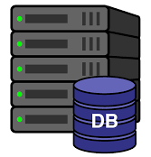
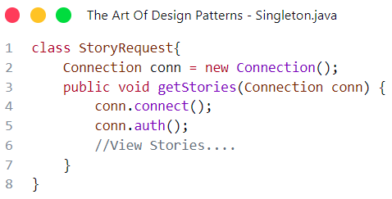
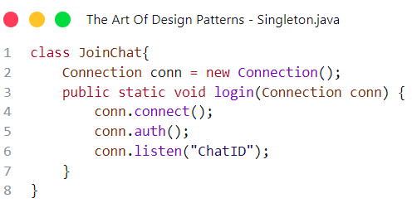
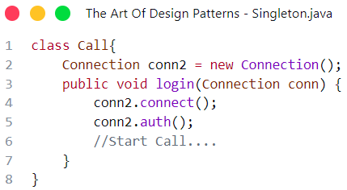
Real life example
available: 3
✅
✅
User wants to view stories
✅
Backend
server
DB connection pool

Slide 15
Real life example
available: 3
User wants to view stories
Backend
server
DB connection pool

Slide 16
Real life example
available: 2
Story Connection
❌
✅
User wants to view stories
✅
Backend
server
DB connection pool
In memory

Slide 17
Real life example
available: 2
Story Connection
User wants to Chat
Backend
server
DB connection pool
In memory

Slide 18
Real life example
available: 1
Story Connection
❌
Chat Connection
❌
User wants to Chat
✅
Backend
server
DB connection pool
In memory
In memory

Slide 19
Real life example
available: 1
Story Connection
❌
Chat Connection
❌
User wants to make Call
✅
Backend
server
DB connection pool
In memory
In memory

Slide 20
Real life example
available: 0
Story Connection
❌
Chat Connection
❌
Call Connection
User wants to make Call
❌
Backend
server
DB connection pool
In memory
In memory
In memory

Slide 21
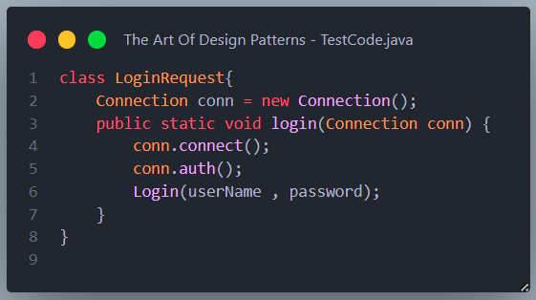
Real life example
available: 0
Story Connection
❌
Chat Connection
❌
Call Connection
Conn, Conn1 and Conn2 are still in memory
❌
Backend
server
DB connection pool
In memory
In memory
In memory

Slide 22
Real life example
available: 0
❌
User wants to make Call
❌
❌
Another User wants to make Call
All Connections
Are busy
❌
Backend
server
DB connection pool

Slide 23
Solution
No need to create a new connection to communicate with the same database every time.
Create a global connection that can be used any where in the app

Slide 24
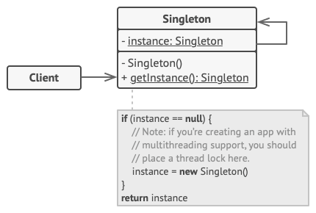
Implementation

Slide 25
Implementation
Make the default constructor private, to prevent other objects from using the new operator with the Singleton class

Slide 26
Implementation
Create a Public Static creation method that acts as a constructor.
Create Private Static instance of the object.
Notes:
Why static ?

Slide 27
Implementation
But Why Static?
Static Variables and Functions can be called directly from the class and don’t require any instance, Which is useful because the constructor is private, also, only one copy of the variable will be available regardless of the number of instances
Notes:
Why static ?

Slide 28
Implementation
The function checks if the object was instantiated before:
If object was found, a reference to the object will be returned
If object was NULL a new one is constructed and saved to the static variable before it gets returned
Notes:
Why static ?

Slide 29
Real life example
available: 1
❌
Login, make Calls and chats over the same opened connections
❌
✅
Backend
server
DB connection pool

Slide 30
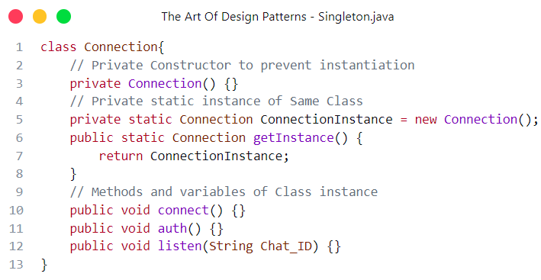
Return the instance directly
Code Implementation 1: Eager initialization

Slide 31
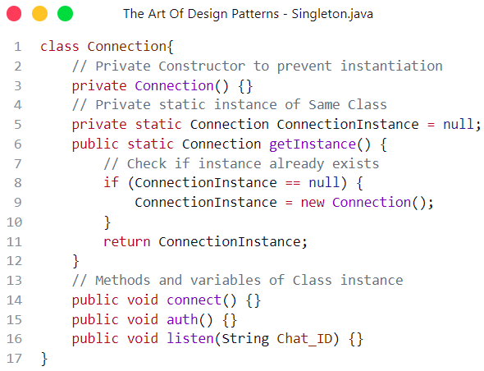
Code
Implementation 2: Lazy initialization

Slide 32

Eager Loading
Singleton instance is initialized once the application starts
Pros:
getInstance() returns instance directly, no need to check
Less complexity in multi-threaded environment
Cons:
Singleton instance will always be allocated in memory and stay during the whole application lifetime even if it was never used

Slide 33

Lazy Loading
Singleton instance is initialized only when object is needed
Pros:
Save memory if the instance is not needed
can be beneficial in scenarios where creating the instance is resource-intensive or time-consuming
Cons:
Harder to implement in multi-threaded environment

Slide 34
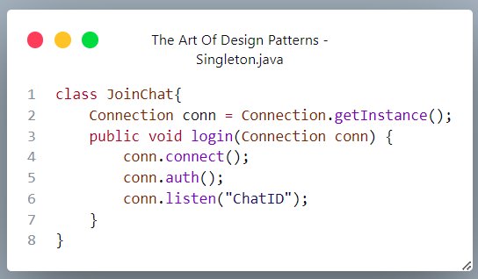
Now to use it simply get a reference to the object using the getInstance() method which returns the singleton object
Now you can call Instance methods (non static ones)

Slide 35
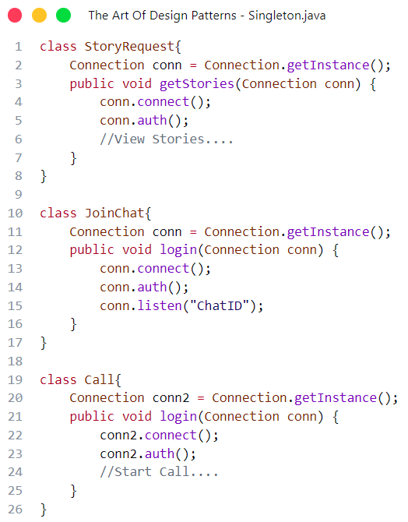
Real life example
available: 1
❌
Login, make Calls and chats over the same opened connections
❌
✅
Backend
server
DB connection pool

Slide 36

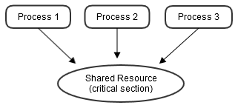
Race conditions in multithreading
If 2 or more objects called getInstance() at the same moment “Due to multithreading” and the Singleton instance is null, The constructor may be called more than once, therefore, it can be considered a critical section

Slide 37
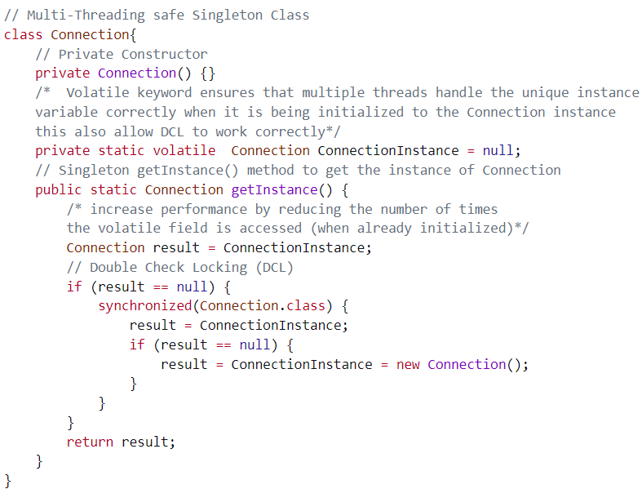
Multithreading-safe
implementation

Slide 40
If already created, we return “result”, so we don’t access Volatile reference twice

Slide 41
Double check Locking:
Check current instance first
If not found, get lock of monitor object and check again
This ensure that critical sections of code are executed atomically, meaning that they are treated as a single, indivisible operation. This prevents race conditions and ensures thread safety.
Notes:
Here's how a synchronized block works:
The monitorObject is an object used for synchronization. It can be any valid Java object, but it should be the same object that multiple threads need to synchronize on.
When a thread encounters a synchronized block, it attempts to acquire the lock on the monitorObject. If the lock is available, the thread enters the synchronized block and starts executing the code within it.
While a thread is inside the synchronized block, it has exclusive access to the shared data protected by the lock. Other threads attempting to enter the same synchronized block will be blocked and must wait until the lock is released.
Once the thread finishes executing the code inside the synchronized block, it releases the lock on the monitorObject. This allows other waiting threads to acquire the lock and enter the synchronized block

Slide 42
And therefore we know that:
Instance is not already created by another thread
No other thread can access Instance until it’s created
Notes:
Here's how a synchronized block works:
The monitorObject is an object used for synchronization. It can be any valid Java object, but it should be the same object that multiple threads need to synchronize on.
When a thread encounters a synchronized block, it attempts to acquire the lock on the monitorObject. If the lock is available, the thread enters the synchronized block and starts executing the code within it.
While a thread is inside the synchronized block, it has exclusive access to the shared data protected by the lock. Other threads attempting to enter the same synchronized block will be blocked and must wait until the lock is released.
Once the thread finishes executing the code inside the synchronized block, it releases the lock on the monitorObject. This allows other waiting threads to acquire the lock and enter the synchronized block

Slide 43
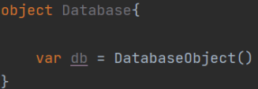


Singleton in other languages
Some languages like Scala and Kotlin have built-in support for singleton by declaring a single instance of a static object sometimes called Companion-Object

Slide 44
When to use Singleton
A Singleton candidate must satisfy three requirements:
To controls concurrent access to a shared resource.
Access to the resource will be requested from multiple, disparate parts of the system.
There can be only one object.
Note: If not all 3 conditions are satisfied, Then using a Mutex or redesigning code may be a better solution

Slide 45
When to use Singleton
Common use cases:
Database connection “DBcontext” Class
Writing to a file on disk
Logging
Need lazy initialization

Slide 46
Pros ✅
You can be sure that a class has only a single instance.
You gain a global access point to that instance.
The singleton object is initialized only when it’s requested for the first time.

Slide 47
Cons ❌
The Singleton pattern can mask bad design, for instance, when the components of the program know too much about each other.
The pattern requires special treatment in a multithreaded environment so that multiple threads won’t create a singleton object several times.
It may be difficult to unit test the client code of the Singleton because many test frameworks rely on inheritance
Singleton breaks single responsibility principle

Slide 48

Any Questions?

Slide 49

Break

Slide 50
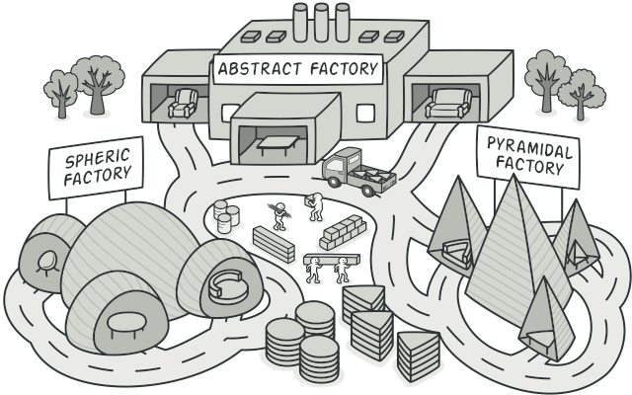
Abstract Factory
Notes:
Remember that design patterns are known solutions to common problems

Slide 51



Problem
Classic furniture factory
Produces classic chairs and sofas
If we need to produce Modern furniture, do we need completely new machines to make chairs and sofas ?
Factory owner wants to also sell Modern furniture

Slide 52


Solution
Furniture factory
Produces chairs and sofas
Classic Furniture production line Produces Classic chairs and sofas
Modern Furniture production line Produces Modern chairs and sofas
Factory owner wants to also sell Modern furniture

Slide 53
Problem details
We needed to produce families of related objects
Both Classic and Modern Furniture consisted of Chairs and Sofas
Therefore, treating them as totally different objects create much overhead
Ex: Both are made of wood - Chairs have 4 legs - Sofas can sit more than one person

Slide 54
Abstract Factory
“Abstract Factory is a creational design pattern that lets you produce families of related objects without specifying their concrete classes.”

Slide 55
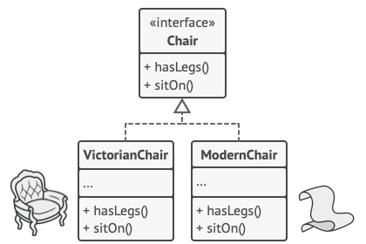
Abstract Factory
Explicitly declare an interface for each distinct product
EX: Modern Chair and Classic Chair both are Chairs

Slide 56
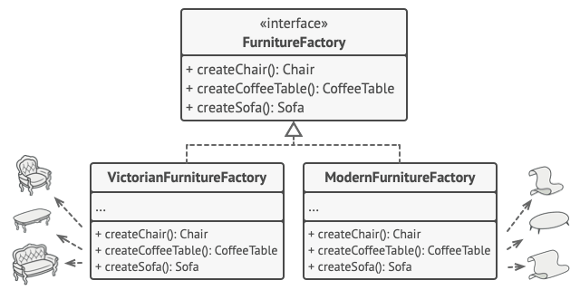
Abstract Factory
Then, Declare the Abstract Factory -> an interface with a list of creation methods for all products that are part of the product family
EX: createChair, createSofa

Slide 57
Abstract Factory
For each variant of a product family, we create a separate factory class based on the AbstractFactory interface. A factory is a class that returns products of a particular kind.
EX: ModernFurnitureFactory can only create ModernChair and ModernSofa

Slide 58
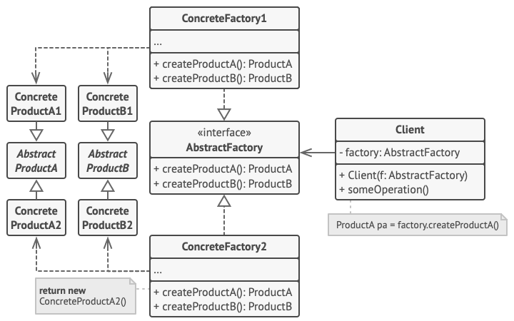
Final structure
Notes:
Client shouldn’t care abut the class of factory it’s dealing with

Slide 59
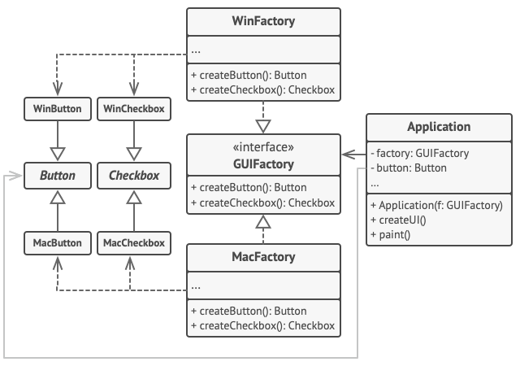
Real life example: Cross-Platform rendering

Slide 60


Real life example: Cross-Platform rendering
minimizeBtn()
maximizeBtn()
closeBtn()
Using MacFactory
Using WinFactory

Slide 61

Your turn
Hands on 1:
Implement the previous example in java

Slide 62
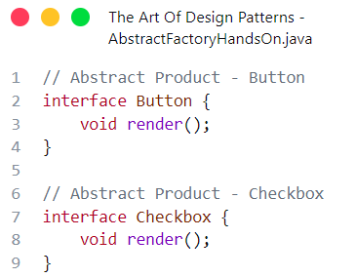
Solution
1- Create abstract products

Slide 63
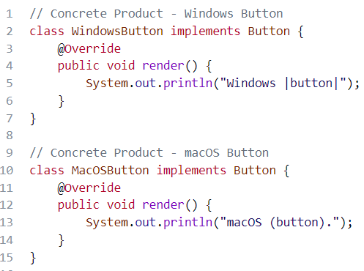
Solution
2- Implement each product for each factory “Button”

Slide 64
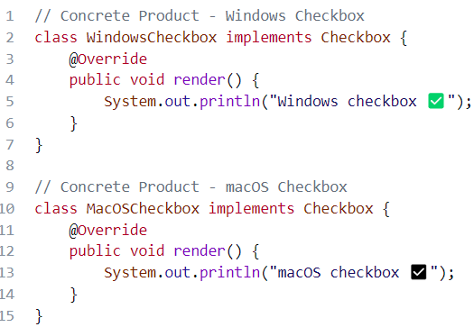
Solution
2- Implement each product for each factory “Checkbox”

Slide 65
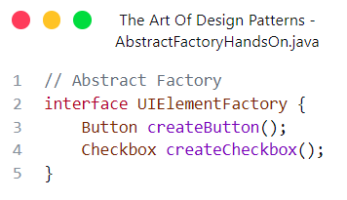
Solution
3- Create abstract factory

Slide 66
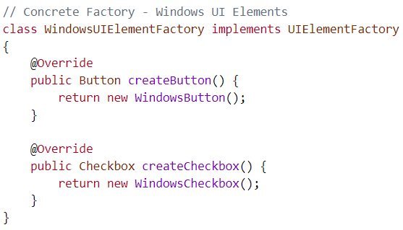
Solution
4- implement factories “Windows ”

Slide 67
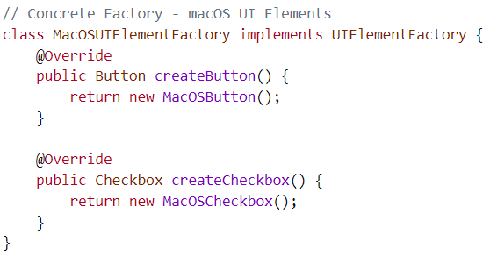
Solution
4- implement factories “MacOS ”

Slide 68
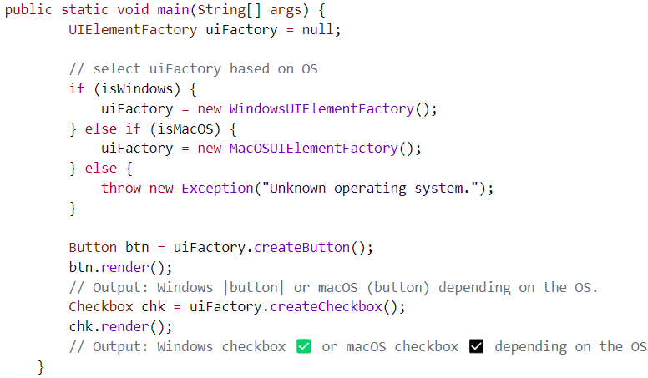
Solution 5 – Use factories
Notes:
Depending on abstraction not implementation

Slide 69
Pros ✅
You can be sure that the products you’re getting from a factory are compatible with each other.
You avoid tight coupling between concrete products and client code.
Single Responsibility Principle. You can extract the product creation code into one place, making the code easier to support.
Open/Closed Principle. You can introduce new variants of products without breaking existing client code.

Slide 70
Cons ❌
The code may become more complicated than it should be, since a lot of new interfaces and classes are introduced along with the pattern.

Slide 71
Any Questions?

Slide 72
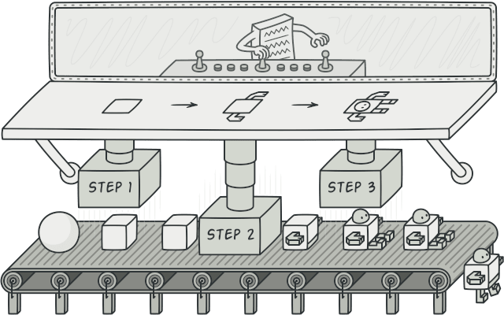
Builder
Notes:
Remember that design patterns are known solutions to common problems

Slide 73
Problem
Imagine a complex object that requires laborious, step-by-step initialization of many fields and nested objects. Such initialization code is usually buried inside a monstrous constructor with lots of parameters. Or even worse: scattered all over the client code.

Slide 74
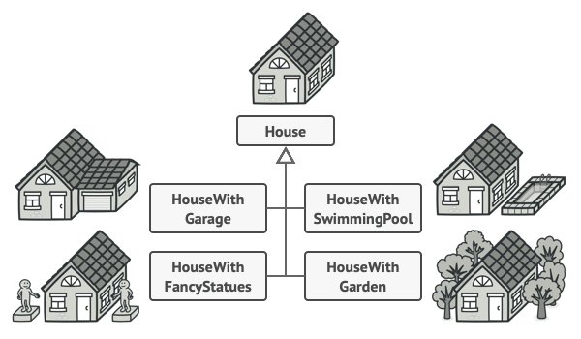
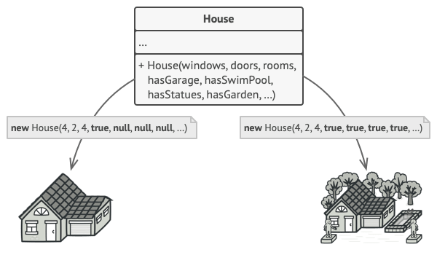
Common solutions
Create many subclasses
Use a large parameterized constructor
Notes:
Both will result in ugly hard to use code

Slide 75
Builder
Builder is a creational design pattern that lets you construct complex objects step by step. The pattern allows you to produce different types and representations of an object using the same construction code.

Slide 76
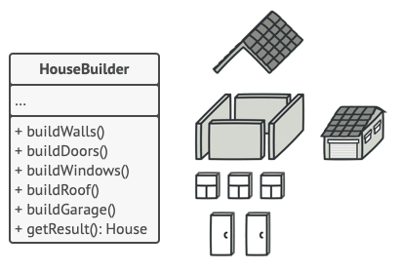
Builder pattern solution
The Builder pattern suggests that you extract the object construction code out of its own class and move it to separate objects called builders.
The Builder doesn’t allow other objects to access the product while it’s being built “Private”

Slide 77
Director: A Builder that knows what to do
You can extract a series of calls to the builder steps you use to construct a product into a separate class called director.
The director class defines the order in which to execute the building steps
The builder provides the implementation for those steps.

Slide 78
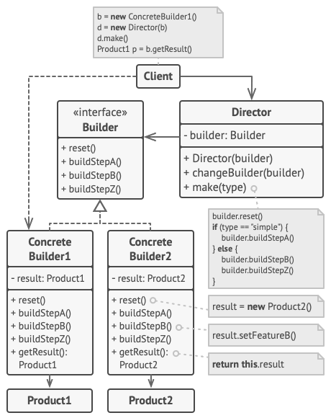
Structure

Slide 79
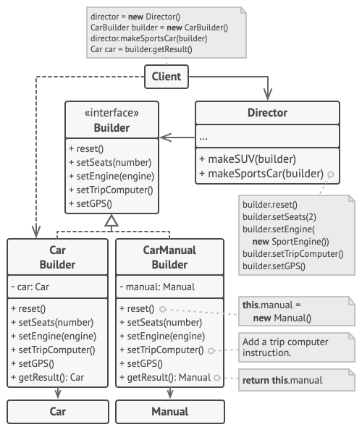
Example

Slide 80
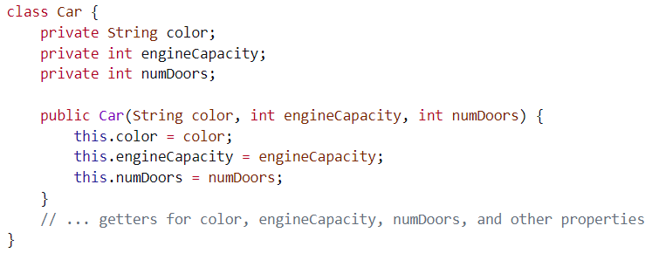
Code Example

Slide 81
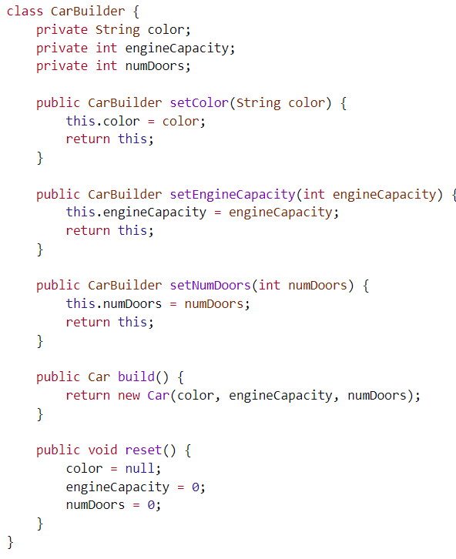
Code Example
Same Car instance fields

Slide 82
Code Example
Building steps

Slide 83
Code Example
Build creates the object and return it
Reset clears all values

Slide 84
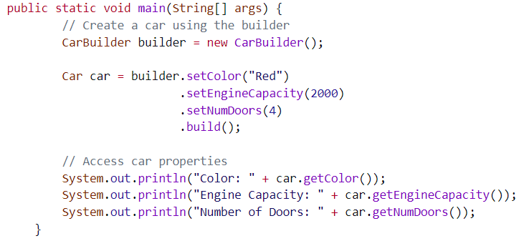
Main()

Slide 85
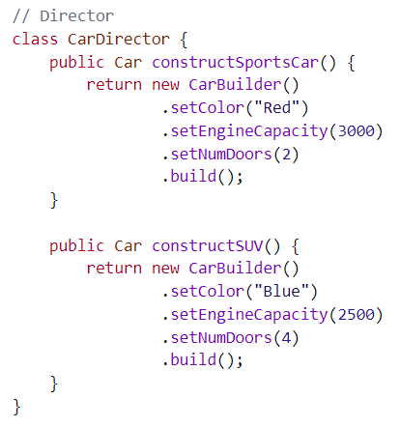
Director class

Slide 86
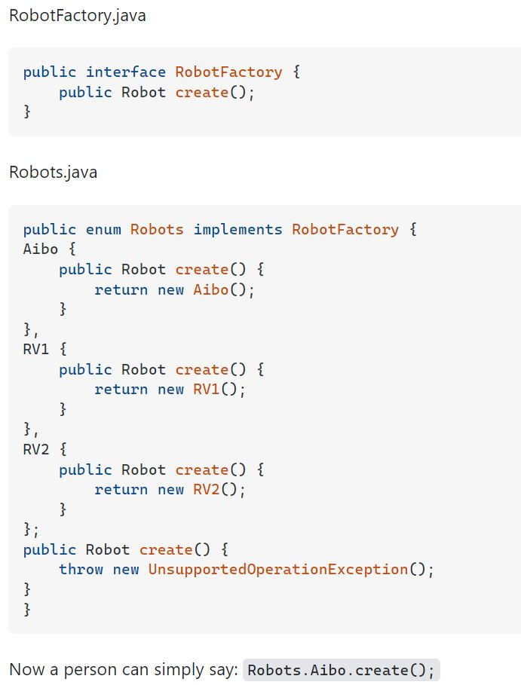
Interface + Enum method “Self study”

Slide 87
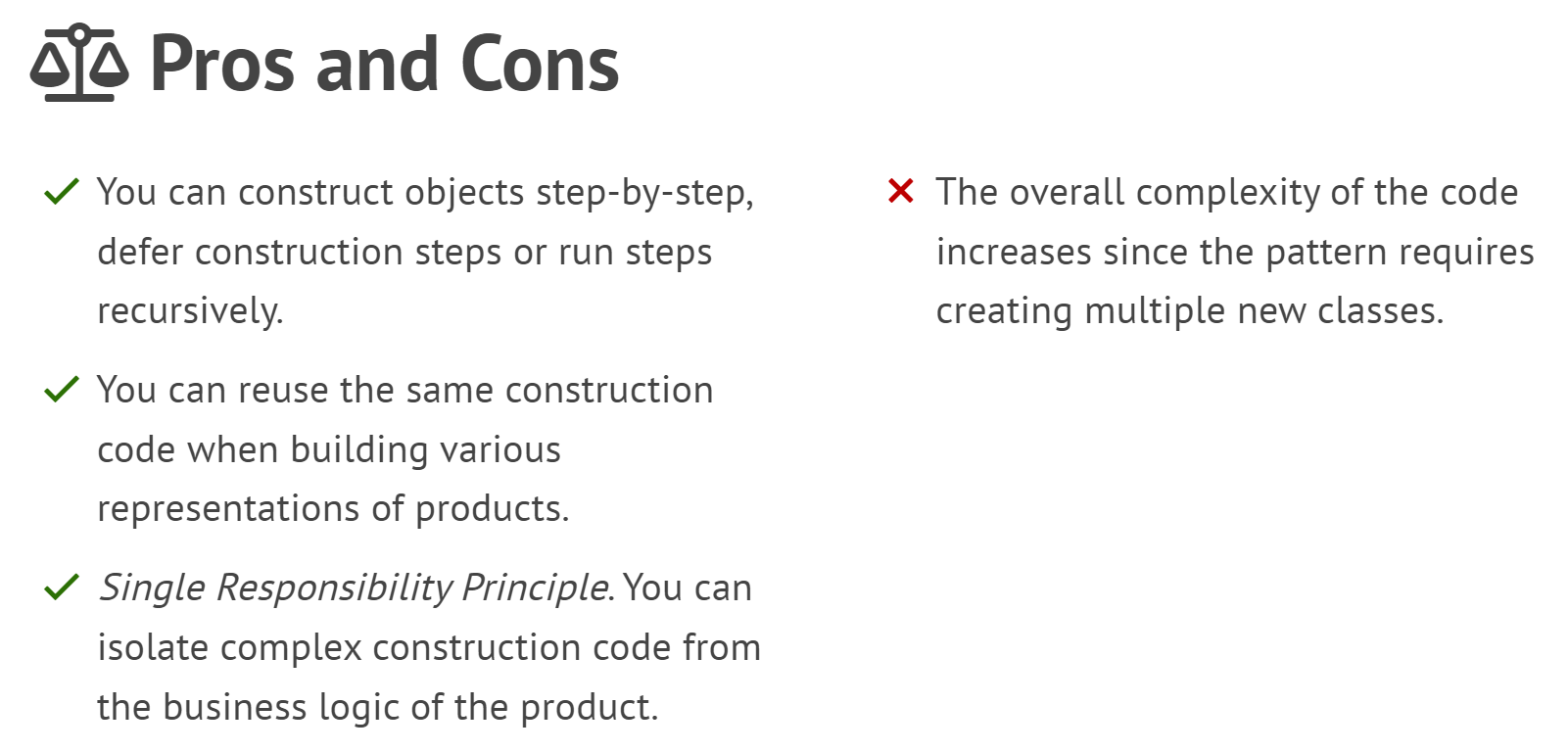

Slide 88
Thank you

